Slide 1


Bacchus Winery
Success Driven by Data
Created By:
Juedeja Richard
Dario Gomez
Scott Macioce
Kristopher Kuenning

Slide 2

Winery Database Solutions
Streamline Your Operations and Boost Sales
Introduction
Case Study
ERD
Reporting
Business Rules

Slide 3


Introduction
As members of the red team, we are excited to present our findings for the Bacchus case study. We offer a fresh prospective to database management in small to medium businesses.
We propose a database strategy that will bring your sales to the next level!

Slide 4

Case Study
The Bacchus brothers inherited their winery and aim to modernize operations for better products and customer service.
Retained existing staff across finance, marketing, production, and distribution.
Current supply inventory tracking and ordering are inefficient, and distribution relies on manual processes.
Need a business snapshot to identify problem areas and improve efficiency
Supplier delivery times
Sales by distributor and Wine
Employee hours worked per quarter.
Bacchus is exploring online solutions for supply ordering and distributor order/tracking.

Slide 5

Business Rules and Assumptions
The system should record the number of hours worked by the employee per quarter.
Track expected and actual delivery dates per shipment.
Various items are used to make wine, like bottles, labels, corks, and vats.
All suppliers, employees, distributors, and products should have their own ID.
4 different types of wine produced.
The winery uses different distributors.
Quantity of bottles sold each month by type and the cost of each bottle.
Track shipments to distributors.
Distributors can order online, with real-time inventory.
Track materials purchased from suppliers.
Assume websites are operational for distribution.
Assume all employees are 40 hours and paid hourly.
Employee schedule times; In and Out times
Online inventory sales update in real-time to project in-stock quantities.

Slide 6

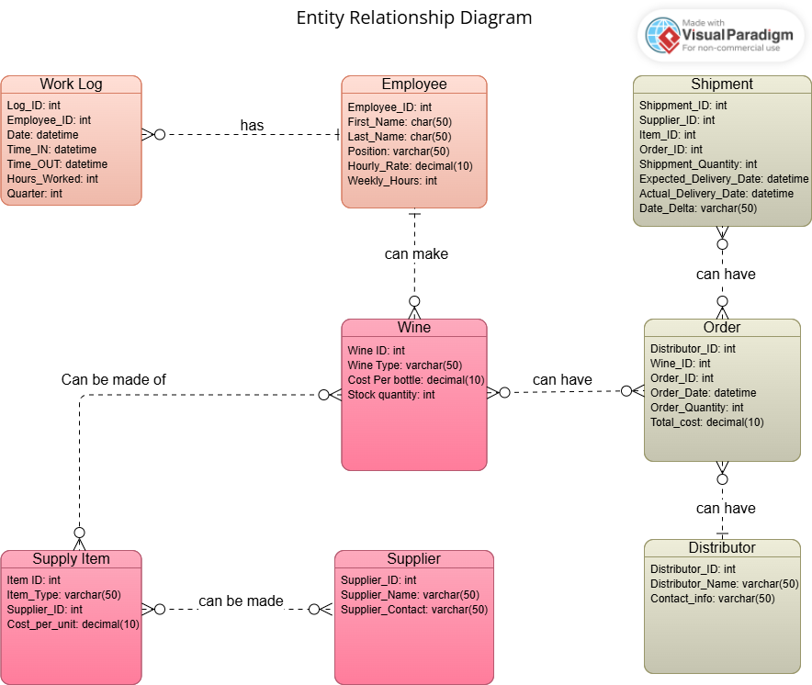
Entity Relationship Diagram

Slide 7

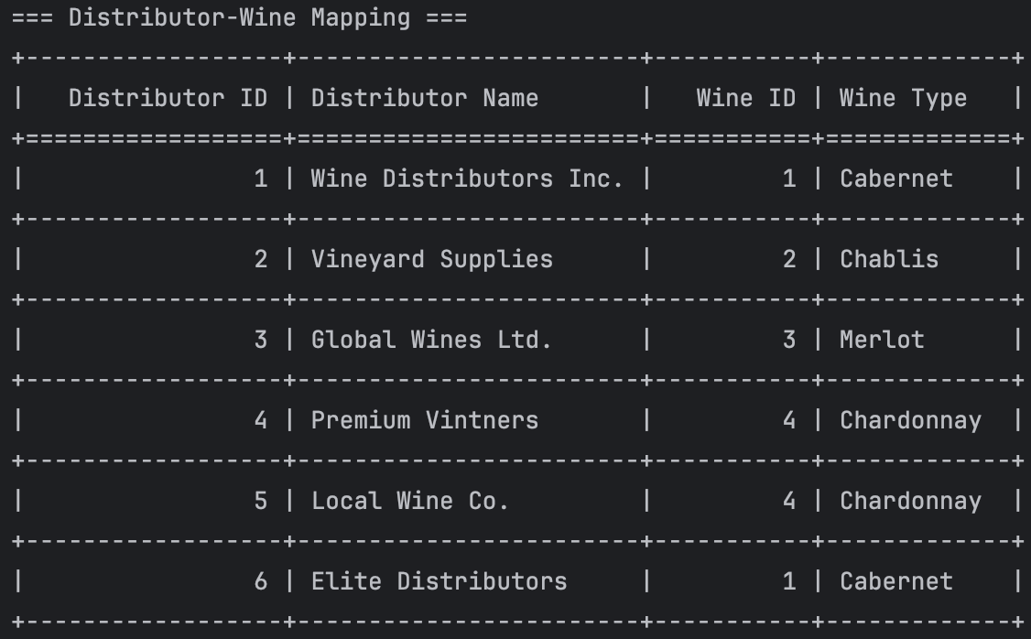
Report #2A
Distribution
Stay in the know of which wines each distributor sells.
Expand wine types to current distributors

Slide 8

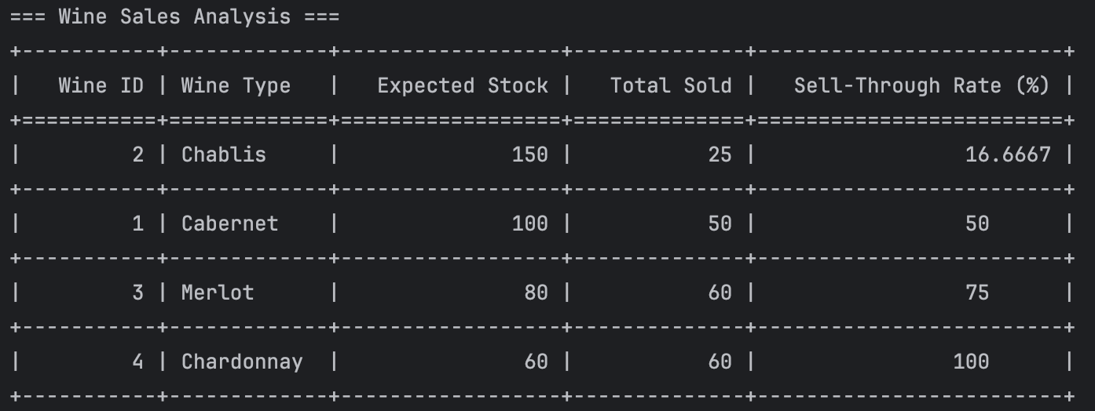
Report #2B
Sales
Understand your best sellers.
Keep the right inventory levels.

Slide 9

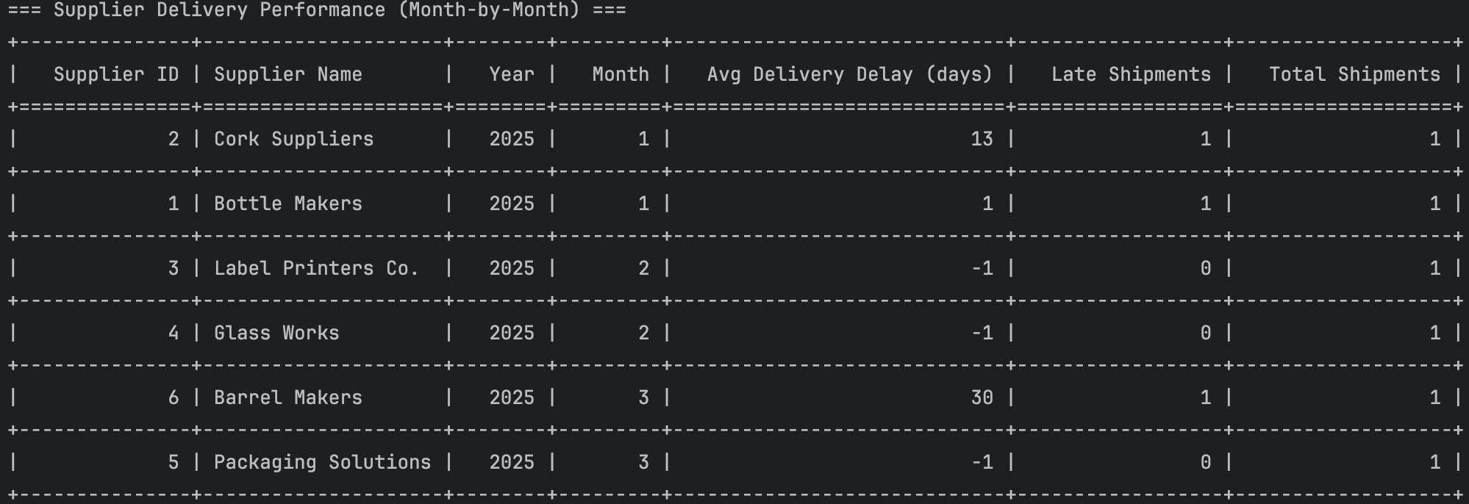
Report #3
Supply Chain
How many shipments per supplier are received per month.
Are your suppliers delivering on time?

